Slide 1
DBMS SQL
Lesson 07 : Introduction to Data Modeling E-R Model and Normalization

Slide 2
Table Of Contents
Introduction to Data Modeling
E-R Model
Normailzation

Slide 3
Definition of a Model
1.1 Introduction to Data Models
An integrated collection of concepts for describing data, relationships between data, and constraints on the data used by an organization.
A representation of ‘real world’ objects and events, and their associations.
It attempts to represent the data requirements of the organization that you wish to model
Modeling is an integral part of the design and development of any system.
A correct model is essential.
Notes:
What is a model?
A model serves two primary purposes:
As a true representation of some aspects of the real world, a model enables clearer communication about those aspects.
A model serves as a blueprint to shape and construct the proposed structures in the real world.
So, what is a data model? A data model is an instrument that is useful in the following ways:
1) A model helps the users or stakeholders clearly understand the database system that is being implemented. It helps them understand the system with reference to the information requirements of an organization.
2) It enables the database practitioners to implement the database system exactly conforming to the information requirements.
A data model, therefore, serves as a critical tool for communication with the users and it also serves as a blueprint of the database system for the developers.
Without a proper data model, an adequate database system cannot be correctly designed and implemented. A good data model forms an essential prerequisite for any successful database system. Unless the data modelers represent the information requirements of the organization in a proper data model, the database design will be totally ineffective.

Slide 4
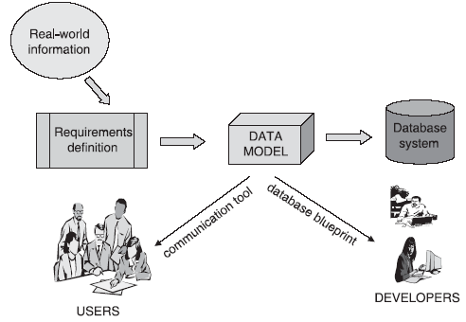
What is Data Modeling?
What is Data Modeling?
Data modeling is a technique for exploring the data structures needed to support an organization’s information need.
It would be a conceptual representation or a replica of the data structure required in the database system.
A data model focuses on which data is required and how the data should be organized.
At the conceptual level, the data model is independent of any hardware or software constraints.
Notes:
What is Data Modeling?
At this level, the data model is generic; it does not vary whether you want to implement an object-relational database, a relational database, a hierarchical database, or a network database.
At the next level down, a data model is a logical model relating to the particular type of database relational, hierarchical, network, and so on. This is because in each of these types, data structures are perceived differently.
If you proceed further down, a data model is a physical model relating to the particular database management system (DBMS) you may use to implement the database.

Slide 5
Why Use Data Modeling?
Leverage
  Data model serves as a blueprint for the database system.
Conciseness
  Data model functions as an effective communication tool for discussions with the users.
Data Quality
  Data model acts as a bridge from real-world information to database storing relevant data content.
Notes:
Why Use Data Modeling?
Leverage: The key reason for giving special attention to data organization is the leverage. A small change to a data model may have a major impact on the whole system. Therefore, you can opt for modifying the data model instead of the system. For the most commercial information systems, the programs are far more complex. Also, considerable time is consumed in specifying and constructing them, as compared to the database. However, their contents and structures are heavily influenced by the database design.
Conciseness: A data model is a very powerful tool for establishing requirements and capabilities of information systems. Its valuable because of its conciseness. It implicitly defines a whole set of screens, reports, and processes needed to capture, update, retrieve, and delete the specified data. The data modeling process can tremendously facilitate our understanding of the essence of business requirements.
Data Quality: The data held in a database is usually a valuable business asset built up over a long period. Inaccurate data (poor data quality) reduces the value of the asset and can be expensive or impossible to correct. Frequently, problems with data quality can be traced back to a lack of consistency in (a) defining and interpreting data, and (b) implementing mechanisms to enforce the definitions.

Slide 6
Entity-Relationship Model
A high-level conceptual data model that is widely used in the design of a database application.
A top-down approach to database design.
The ER model represents data in terms of these:
  Entities (Independent, dependent or Associative)
  Attributes of entities
  Relationships between entities
It is independent of the h/w or s/w used for implementation. Although we can use an ER model as a basis for hierarchical, network and relational databases, it is strongly connected to the relational databases.
Notes:
What is Entity-Relationship Model?
Entities are the principal data objects about which information is to be collected. Entities are usually recognizable concepts, either concrete or abstract, such as person, places, things, or events which have relevance to the database. Some specific examples of entities are EMPLOYEES, PROJECTS, INVOICES. An entity is analogous to a table in the relational model.
Attributes
Attributes describe the entity with which they are associated. A particular instance of an attribute is a value. The domain of an attribute is the collection of all possible values an attribute can have. The domain of Name is a character string.
Attributes can be classified as identifiers or descriptors. Identifiers, more commonly called keys, uniquely identify an instance of an entity. A descriptor describes a non-unique characteristic of an entity instance.

Slide 7
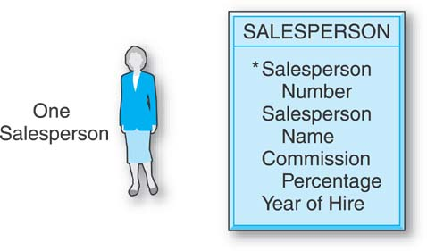
Entities
People, places, objects, things, events, or concepts (nouns).
  Examples: Employee, salesperson, sale, account, department.
Represented as a rectangle in ERD.
Entity type versus entity instance:
  Entity instance: A single example of an entity.
  Entity type: A collection of all entity instances of a single type.
Notes:
The basic concept of the ER model is an entity, which represents a set of
objects in the ‘real world’ that share the same properties. Each object, which should be uniquely identifiable within the set, is called an entity occurrence. An entity has an independent existence and can represent objects with a physical (or ‘real’) existence or objects with a conceptual (or ‘abstract’) existence

Slide 8
Attributes
Attributes describe the entity with which they are associated.
They are characteristics of an Entity.
Eg: Customer Name is an attribute of the entity Customer.

Slide 9
Types of Attributes
Simple Attribute: An attribute composed of a single component with an independent existence. E.g SSN, BirthDate
Composite Attribute: An attribute composed of multiple components, each with an independent existence. E.g Name attribute of the entity that can be subdivided into FirstName ,LastName attributes
Notes:
Attributes
A particular instance of an attribute is a value. For example, “S Ranjan" is one of the values of the attribute Name. The domain of an attribute is the collection of all possible values an attribute can have. The domain of Name is a character string.
Attributes can be classified as identifiers or descriptors. Identifiers, more commonly called keys, uniquely identify an instance of an entity. A descriptor describes a non-unique characteristic of an entity instance.

Slide 10
Types of Attributes
3.7: Entity-Relationship Model
Single-Valued Attribute: An attribute that holds a single value for each occurrence. E.g.SSN
Multi-Valued Attributes: An attribute that holds multiple values for each occurrence. E.g Hobbies
Derived Attributes: An attribute that represents a value that is derivable from the value of a related attribute or set of attributes, not necessarily in the same entity type.
E.g Age whose value is derived from the Current Date and BirthDate attribute.
Notes:
Attributes
Attributes describe the entity with which they are associated. A particular instance of an attribute is a value. For example, “S Ranjan" is one of the values of the attribute Name. The domain of an attribute is the collection of all possible values an attribute can have. The domain of Name is a character string.
Attributes can be classified as identifiers or descriptors. Identifiers, more commonly called keys, uniquely identify an instance of an entity. A descriptor describes a non-unique characteristic of an entity instance.

Slide 11
Relationship
A relationship represents an association between two or more entities. An example of a relationship would be as follows:
  Employees are assigned to projects.
  Projects have subtasks.
  Departments manage one or more projects.

Slide 12
Key Types
Superkey:
An attribute, or set of attributes, that uniquely identifies each entity occurrence.
If we add additional attributes to a primary key, the resulting combination would still uniquely identify an instance of the entity set. Such augmented keys are called superkey
Candidate Key:
A superkey that contains only the minimum number of attributes necessary for unique identification of each entity occurrence. Ex. BranchNo in entity Branch.
The minimal super key is also referred as candidate key

Slide 13
Key Types
Primary Key: The candidate key that is selected to uniquely identify each occurrence of an entity type.E.g: National Insurance Number.
Alternate keys: The candidate keys that are not selected as the primary key of the entity.
Composite Key: A candidate key that consist of two or more attributes.
Notes:
Primary Keys: The candidate key that is selected to identify each entity occurrence.
They are a strong concept that is usually enforced for every table.
• They can be made up of one or more columns; each has to be mandatory.
• They are declarative as a constraint and can be named. When creating a primary key constraint, Oracle automatically creates a unique index in association with it.
• A foreign key usually refers to the primary key of a table, but may also refer to a unique key.
Tables that do not have a primary key should have a unique key.
Unique Keys: A unique key is a key that for some reason was not selected to be the primary key. The reasons may have been:
• Allowed nulls. Nulls may be allowed in Unique keys columns.
• Updatable. Unique key values may change but still need to remain unique. For example, the home phone number of an employee or the license plate for a car.
There may be more than one unique key for each table.

Slide 14
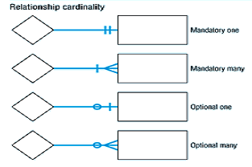
Notations Used for ER Model
ENTITY TYPE
WEAK ENTITY TYPE
RELATIONSHIP TYPE
IDENTIFYING RELATIONSHIP TYPE
ATTRIBUTE
KEY ATTRIBUTE
MULTIVALUED ATTRIBUTE
COMPOSITE ATTRIBUTE
DERIVED ATTRIBUTE
Notes:
Notations Used for ER Model:
Entities are represented by labeled rectangles. The label is the name of the entity. Entity names should be singular nouns.
Relationships are represented by a solid line connecting two entities. The name of the relationship is written above the line. Relationship names should be verbs.
Attributes, when included, are listed inside the entity rectangle. Attributes which are identifiers are underlined. Attribute names should be singular nouns.
Cardinality of many is represented by a line ending in a crow's foot. If the crow's foot is omitted, the cardinality is one.
Existence is represented by placing a circle or a perpendicular bar on the line. Mandatory existence is shown by the bar (looks like the number 1) next to the entity that has a mandatory instance. Optional existence is shown by placing a circle next to the entity that is optional.

Slide 15
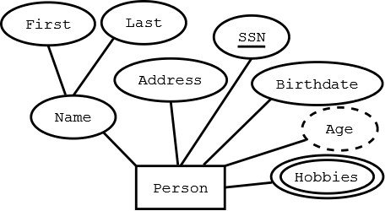
Attribute Notations
Notes:
Rectangle -- Entity
Ellipses -- Attribute (underlined attributes are [part of] the primary key)
Double ellipses -- multi-valued attribute
Dashed ellipses-- derived attribute, e.g. age is derivable from birthdate and current date.

Slide 16
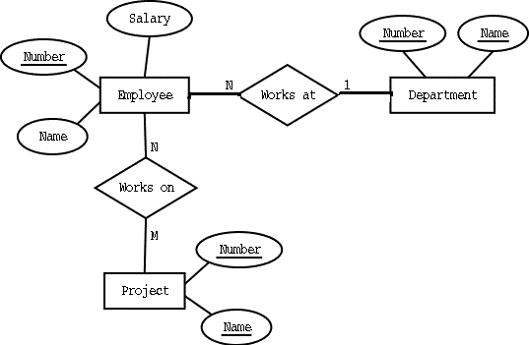
The E-R Model - An Example

Slide 17
The Different ER Relationships (cont..)
Degree of Relationships
  The degree of a relationship is the number of entities associated with the relationship
Notes:
Degree of Relationship
The degree of a relationship is the number of entities associated with the relationship. The n-ary relationship is the general form for degree n. Special cases are the binary and ternary, with the degree 2 and 3 respectively.
Binary relationship is the most common type of association in the real world and is defined between two entities. A recursive binary relationship occurs when an entity is related to itself. An example might be "some employees are married to other employees".
A ternary relationship involves three entities and is used when a binary relationship is inadequate. Many modeling approaches recognize only binary relationships. Ternary or n-ary relationships are disintegrated into two or more binary relationships.

Slide 18
Degree of a Relationship
Unary:
  Recursive relationship between instances of ONE entity type.
  Example: Salesperson MANAGES Salesperson.
Binary:
  Relationship between instances of TWO entity types (most common).
  Example: Salesperson SELLS product.
Ternary:
  Relationship among instances of THREE entity types.
  Example: Salesperson SELLS product TO customer.
Notes:
The entities involved in a particular relationship are referred to as participants. The number of participants in a relationship is called the degree and indicates the number of entities involved in a relationship. A relationship of degree one is called unary, which is commonly referred to as a recursive relationship. A relationship of degree two is called binary. The two relationships shown. A relationship of a degree higher than binary is called a complex relationship. A relationship of degree three is called ternary. A relationship of degree four is called quaternary, and a relationship of a higher degree is called n-ary. The most popular type of relationship you’ll come across is binary, but occasionally you’ll come across unary or ternary, and less frequently quaternary.

Slide 19
Types of Binary Relationships
One-to-one (1:1) binary relationship:
  One instance of an entity type is related to only one instance of another entity type, and vice versa.
    Line 3.1.1
  Example: A salesperson can have only ONE office; an office can be assigned to only ONE salesperson.
One-to-many (1:N) binary relationship:
  One instance of an entity type (the “one” side) is related to many instances of another entity type (the “many” side), but an entity instance on the “many” side can be related to only one instance on the “one” side.
  Example: A salesperson can have MANY sales transaction, but one sales transaction can only be done by ONE salesperson.

Slide 20
Types of Binary Relationships
Many-to-many (M:N) binary relationship:
  Instances of each entity type can be related to many instances of the other entity type.
  Example: A salesperson can sell MANY products, and a product can be sold by MANY salespersons.

Slide 21
Normalization
Normalization is a technique for designing relational database tables.
Normalization is used:
  to minimize duplication of information
  to safeguard the database against certain types of problems
Thus, Normalization is a process of efficiently organizing data in a database.
Normalization is done within the framework of five normal forms(numbered from first to fifth).
Most designs conform to at least the third normal form.
Normalization rules are designed to prevent anomalies and data inconsistencies.

Slide 22
Goals of the Normalization
Goals of the Normalization process are:
  to eliminate redundant data
  to ensure that data dependencies make sense
Thus Normalization:
  reduces the amount of space a database has consumed
  ensures that data is logically stored
Notes:
Normalization (contd.):
Higher degrees of normalization typically involve more tables and create the need for a larger number of joins, which can reduce performance.
Accordingly:
More highly normalized tables are typically used in database applications involving many isolated transactions
For example: an Automated teller machine
While less normalized tables tend to be used in database applications that need to map complex relationships between data entities and data attributes
For example: a reporting application, or a full-text search application
Database theory describes a table’s degree of normalization in terms of Normal Forms of successively higher degrees of strictness.
For example: A table in Third Normal form (3NF), is consequently in Second Normal form (2NF) as well but the reverse is not necessarily true.
Although the Normal Forms are often defined informally in terms of the characteristics of tables, rigorous definitions of the Normal Forms are concerned with the characteristics of mathematical constructs known as “Relations”. Whenever information is represented relationally, it is meaningful to consider the extent to which the representation is normalized.

Slide 23
Benefits of Normalization
Benefits of Normalization are given below:
  Greater overall database organization
  Reduction of redundant data
  Data consistency within the database
  A much more flexible database design
  A better handle on database security

Slide 24
Problems with un-normalized database
An un-normalized database can suffer from various “logical inconsistencies” and “data operation anomalies”.
Data Operation anomalies can be classified as:
  Update anomaly
  Insertion anomaly
  Deletion anomaly
Notes:
The purpose of Normalization is to ensure:
there is no duplication of data
there is no unnecessary data stored within a Database
all the attributes (columns) of a table are completely dependent on the primary key of a table only, and not on any other attribute.

Slide 25
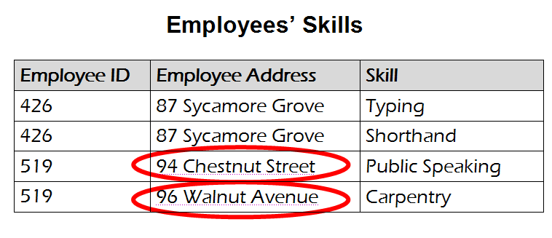
Update anomaly
The slide shows an Update anomaly.
Employee 519 is shown as having different addresses on different records.
Notes:
Update anomaly:
The same information can be expressed on multiple records. Therefore updates to the table may result in logical inconsistencies.
For example: Each record in an “Employees’ Skills” table might contain an Employee ID, Employee Address, and Skill. Thus a change of address for a particular employee will potentially need to be applied to multiple records (one for each of his skills). If the update is not carried through successfully — that is, if the employee’s address is updated on some records but not on others — then the table is left in an inconsistent state. Specifically, the table provides conflicting answers to the question of what is the address of a particular employee. This phenomenon is known as an “Update anomaly”.
The slide shows an Update anomaly. Employee 519 is shown as having different addresses on different records.

Slide 26
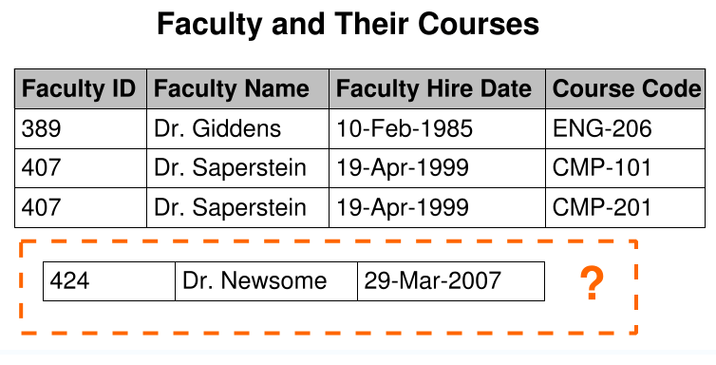
Insertion anomaly
The slide shows an example of an Insertion anomaly.
Until the new faculty member is assigned to teach at least one course, the details cannot be recorded.
Notes:
Insertion anomaly:
There are circumstances in which certain facts cannot be recorded at all.
For example: Each record in “Faculty and Their Courses” table might contain a Faculty ID, Faculty Name, Faculty Hire Date, and Course Code — thus we can record the details of any faculty member who teaches at least one course. However, we cannot record the details of a newly-hired faculty member who has not yet been assigned to teach any courses. This phenomenon is known as an “Insertion anomaly”.
The slide shows an Insertion anomaly. Until the new faculty member is assigned to teach at least one course, his details cannot be recorded.

Slide 27
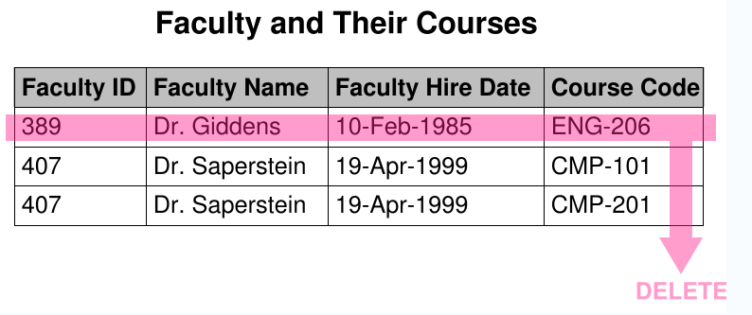
Deletion anomaly
The slide shows an example of a Deletion anomaly.
All information about Dr. Giddens is lost when he temporarily ceases to be assigned to any course.
Notes:
Deletion Anomaly:
There are circumstances in which the deletion of data representing certain facts necessitates the deletion of data representing completely different facts. The “Faculty and Their Courses” table described in the previous example suffers from this type of anomaly. If a faculty member temporarily ceases to be assigned to any course, we must delete the last of the records on which that faculty member is displayed. This phenomenon is known as a “Deletion anomaly”.
The slide shows a Deletion anomaly. All information about Dr. Giddens is lost when he temporarily ceases to be assigned to any courses.

Slide 28
Background to Normalization: Functional dependency
Let us suppose we have two columns A and B, such that, for given value of column A there is a single value of column B associated with it. Then column B is said to be functionally dependent on column A.
Column B is functionally dependent on column A is equivalent to saying that column A determines(identifies) column B.
The same can be notified as A → B
Eg: Employee Address has a functional dependency on Employee ID because a particular Employee ID value corresponds to one and only one Employee Address value.
EmpID → EmpAddress
Notes:
Note that the reverse need not be true. Several employees can live at the same address and therefore one Employee Address value can correspond to more than one Employee ID. Employee ID is therefore not functionally dependent on Employee Address.
An attribute may be functionally dependent either on a single attribute or on a combination of attributes. It is not possible to determine the extent to which a design is normalized without understanding what functional dependencies apply to the attributes within its tables. Understanding this concept, in turn, requires knowledge of the problem domain.

Slide 29
Background to Normalization (contd…)
Notes:
Background to Normalization (contd.):
Three Types of Functional Dependencies
Full Dependency: In a relation, the attribute(s) B is fully functional dependent on A, if B is functionally dependent on A but not on any proper subset of A.
Partial Dependency: It is a relation, where there is some attribute that can be removed from A and the dependency still holds.
For example: Staff_No, Sname → Branch_No
Transitive Dependency: In a relation, if attribute(s) A→B and B→C, then C is transitively dependent on A via B (provided that A is not functionally dependent on B or C)
For example: Staff_No → Branch_No, and Branch_No → BAddress
For example: {Employee Address} has a functional dependency on {Employee ID, Skill}, but not a full functional dependency, because it is also dependent on {Employee ID}.
Trivial functional dependency: A trivial functional dependency is a functional dependency of an attribute on a superset of itself. {Employee ID, Employee Address} → {Employee Address} is trivial, as is {Employee Address} → {Employee Address}.
Transitive dependency: A transitive dependency is an indirect functional dependency, one in which X → Z only by virtue of X→Y and Y→Z.
Multivalued dependency: A multi-valued dependency is a constraint according to which the presence of certain rows in a table implies the presence of certain other rows. Refer the Multivalued Dependency article for a rigorous definition.
Join dependency: A table T is subject to a join dependency if T can always be recreated by joining multiple tables each having a subset of the attributes of T.
Superkey: A super key is an attribute or set of attributes that uniquely identifies rows within a table. In other words, two distinct rows are always guaranteed to have distinct superkeys. {Employee ID, Employee Address, Skill} will be a superkey for the “Employees’ Skills” table; {Employee ID, Skill} will also be a superkey.
Candidate key: A candidate key is a minimal superkey, that is a superkey for which we can say that no proper subset of it is also a superkey. {Employee Id, Skill} will be a candidate key for the “Employees’ Skills” table.
Non-prime attribute: A non-prime attribute is an attribute that does not occur in any candidate key. Employee Address will be a non-prime attribute in the “Employees’ Skills” table.
Primary key: Most DBMSs require a table to be defined as having a single unique key, rather than a number of possible unique keys. A primary key is a key which the database designer has designated for this purpose.

Slide 30
Normal Forms
Normal Form is abbreviated as NF.
Normal Form provides criteria for determining a table’s degree of vulnerability to logical inconsistencies and anomalies.
The higher the NF applicable to a table, the less vulnerable it is to inconsistencies and anomalies.
Notes:
Normal Forms:
The Normal Forms (abbrev. NF) of relational database theory provide criteria for determining a table’s degree of vulnerability to logical inconsistencies and anomalies. The higher the Normal Form applicable to a table, the less vulnerable it is to inconsistencies and anomalies.
Each table has a “highest normal form” (HNF). By definition, a table always meets the requirements of its HNF and of all normal forms lower than its HNF. Again by definition, a table fails to meet the requirements of any Normal Form higher than its HNF.
The Normal Forms are applicable to individual tables. To say that an entire database is in normal form n implies that all its tables are in normal form n.
Newcomers to database design sometimes suppose that normalization proceeds in an iterative fashion, i.e. a 1NF design are first normalized to 2NF, then to 3NF, and so on. This is not an accurate description of how normalization typically works. A sensibly designed table is likely to be in 3NF on the first attempt. Furthermore, if it is 3NF, it is overwhelmingly likely to have an HNF of 5NF. Achieving the “higher” normal forms (above 3NF) does not usually require an extra expenditure of effort on the part of the designer, because 3NF tables usually need no modification to meet the requirements of these higher normal forms.
Edgar F. Codd originally defined the first three normal forms (1NF, 2NF, and 3NF). These normal forms have been summarized as requiring that all non-key attributes be dependent on “the key, the whole key and nothing but the key”. The fourth and fifth normal forms (4NF and 5NF) deal specifically with the representation of many-to-many and one-to-many relationships among attributes. Sixth normal form (6NF) incorporates considerations relevant to temporal databases.

Slide 31
Un-normalized Relation
An Unnormalized NF relation is a table that contains one or more Repeating Groups or Non-Atomic values.

Slide 32
Case Study: Normalization
Given an EmpProject Table structure
Note: EmpProject is an un-normalized relation
Proj Proj Proj Empno Ename Grade Sal Proj Alloc
Code Type Desc scale Join Date Time
001 APP LNG 46 JONES A1 5 12/1/1998 24
001 APP LNG 92 SMITH A2 4 2/1/1999 24
001 APP LNG 96 BLACK B1 9 2/1/1999 18
004 MAI SHO 72 JACK A2 4 2/4/1999 6
004 MAI SHO 92 SMITH A2 4 5/5/1999 6

Slide 33
Normalization
Problems with the above kind of implementation
  Data Redundancy : Proj. type and description are unnecessarily repeated many times.
  An employee can’t logically exist.
  If project type changes many records will require updating in an identical manner.
  If employee Smith gains promotion, many records will require updating.
  If management decides to change the relationship between the grade and salary scale then many updates will be required.

Slide 34
Normalization – First Normal Form (1 NF)
A relation is said to be in “First Normal Form” (1NF) if and only if all its attributes assume only atomic values and there are no repeating groups.
  1NF requires that the values in each column of a table are “atomic”.
  “Atomic” implies that there are no sets of values within a column.
To Transform un-normalized relation in 1 NF:
Eliminate repeating groups.
Make a separate table for each set of related attributes, and give each table a primary key.
Notes:
First Normal Form (1NF):
A table is in first normal form (1NF) if and only if it faithfully represents a relation. Given that database tables embody a relation-like form, the defining characteristic of one in First Normal form is that it does not allow duplicate rows or nulls. To put it simply, a table with a unique key (which, by definition, prevents duplicate rows) and without any nullable columns is in 1NF.
Note:
The restriction on nullable columns as a 1NF requirement, as espoused by Chris Date, et. al., is controversial. This particular requirement for 1NF is a direct contradiction to Dr. Codd’s vision of the relational database, in which he stated that “null values” must be supported in a fully relational DBMS in order to represent “missing information and inapplicable information in a systematic way, independent of data type”.
By redefining 1NF to exclude nullable columns in 1NF, no level of normalization can ever be achieved unless all nullable columns are completely eliminated from the entire database. This is in line with Date’s and Darwen’s vision of the perfect relational database, however it can introduce additional complexities in SQL databases to the point of impracticality.
contd.

Slide 35
Normalization – First Normal Form (1 NF)
Rule:
  A relation is in the first normal form if the intersection of any column and row contains only one value
  Identify any suitable primary key
  Remove repeating groups to simplify relationship that may lead to multiple table design
Table I
Table II
Proj Code
Emp No
Ename
Grade
Sal Scale
Proj Join Date
Alloc Time
composite
Key
Proj Code
Proj Type
Proj Desc
PK

Slide 36
Normalization – Second Normal Form (2 NF)
A relation is in Second Normal Form (2NF) if and only if it is in 1NF and every non-key attribute is fully functionally dependent on the complete primary key of the relation.
2NF is based on the concept of Full Functional Dependency.
Notes:
Second Normal Form (2NF):
Where the First Normal Form deals with atomicity of data, the Second Normal Form (or 2NF) deals with relationships between composite key columns and non-key columns. As stated earlier, the normal forms are progressive, so to achieve Second Normal form, your tables must already be in First Normal Form.
In case of the Second Normal form (or 2NF), any non-key columns must depend on the entire primary key. In the case of a composite primary key, this means that a non-key column cannot depend on only part of the composite key.

Slide 37
Normalization – Second Normal Form (2 NF)
Transform 1 NF to 2 NF :
If a non-key attribute depends on only part of a composite key,
remove it to a separate table.
  For every relation with a single data item making up the primary key, this rule should “always be true”.
  For those with the composite key, examine every column and ask whether its value depends on the whole of the composite key or just some part of it.
  Remove those that depend only on part of the key to a new relation with that part as the primary key.
Notes:
Rules for 2NF:
The Second Normal Form involves the idea of Functional Dependency.
Functional Dependency: Attribute B has a functional dependency on attribute A, if for each value of attribute A, there is exactly one value of attribute B.
For example: In an Emp table, Employee Address has a functional dependency on Employee ID because a particular Employee ID value corresponds to one and only one Employee Address value.
Note that the reverse need not be true.
For example: Several employees can live at the same address, and therefore one Employee Address value can correspond to more than one Employee ID. Employee ID is therefore not functionally dependent on Employee Address.
An attribute may be functionally dependent either on a single attribute or on a combination of attributes. It is not possible to determine “the extent to which a design is normalized” without understanding the “functional dependencies” that apply to the attributes within its tables.
Understanding this concept, in turn, requires knowledge of the problem domain.
For example: An Employer may require certain employees to split their time between two locations, such as New York City and London, and therefore want to allow Employees to have more than one Employee Address. In this case, Employee Address will no longer be functionally dependent on Employee ID.
contd.

Slide 38
Normalization – Second Normal Form (2 NF)
PK
composite
Key
PK
Table I
Table II
Table III
Proj Code
Proj Type
Proj Desc
Proj Code
Emp No
Proj Join Date
Alloc Time
Emp No
Ename
Grade
Sal Scale

Slide 39
Normalization – Third Normal Form (3 NF)
A relation is in 3NF if and only if it is in 2NF and every non-key attribute is non-transitively dependent on the primary key of the relation.
3NF is based on the concept of transitive dependency.
Notes:
Third Normal Form (3NF):
Third Normal Form (3NF) requires that all columns depend directly on the primary key. Tables violate the Third Normal Form when one column depends on another column, which in turn depends on the primary key (a transitive dependency).
One way to identify transitive dependencies is to look at your table, and see if any columns require updating if another column in the table is updated. If such a column exists, it probably violates 3NF.
Third Normal Form: Eliminate Data Not Dependent On Key

Slide 40
Normalization – Third Normal Form (3 NF)
Rules for 3NF are:
  Examine every non-key column and question its relationship with every other non-key column.
  If there is a transitive dependency, then remove both the columns to a new relation.
Notes:
Criteria for 3NF:
The table must be in 2NF.
Every non-prime attribute of the table must be non-transitively dependent on each candidate key. A violation of 3NF will mean that at least one non-prime attribute is only indirectly dependent (transitively dependent) on a candidate key.
For example:
Consider a “Departments” table whose attributes are Department ID, Department Name, Manager ID, and Manager Hire Date. And suppose that each manager can manage one or more departments. {Department ID} is a candidate key.
Although Manager Hire Date is functionally dependent on the candidate key {Department ID}, this is only because Manager Hire Date depends on Manager ID, which in turn depends on Department ID.
This transitive dependency means the table is not in 3NF unless the manager can be hired for more than one department and the date represents the hiring date of that manager only for this department.

Slide 41
Normalization – Third Normal Form (3 NF)
PK
composite
Key
Table I
PK
Table II
Table III
Proj Code
Proj Type
Proj Desc
Proj Code
Emp No
Proj Join Date
Alloc Time
Emp No
Ename
Grade
PK
Table IV
Grade
Sal Scale

Slide 42
Normalization Summarization
1 NF- Ensure all values are atomic and
Eliminate Repeating Groups
2 NF- Eliminate Partial Dependencies
3 NF- Eliminate Transitive Dependencies

Slide 43
Drawbacks of Normalization
  Typically, in a normalized database, more joins are required to pull together information from multiple tables.
  Joins require additional I/O to process, and are therefore more expensive from a performance standpoint than single-table lookups.
  Additionally, a normalized database often incurs additional CPU processing. CPU resources are required to perform join logic and to maintain data and referential integrity.

Slide 44

Summary
In this lesson, you have learnt that:
  Data Modeling
  E-R Modeling
  Normalization
    Problems with un-normalized database
    Normal Forms
    Benefits of Normalization
    Drawbacks of Normalization

Slide 45

Review Question
Question 1: The higher the NF applicable to a
table, the less vulnerable it is to inconsistencies
and anomalies.
  True/False
Question 2: ____remove partial key dependencies

